Slide 1

Digitalized Transport System
Project ID: 14
Mariam Fatima (2k16/swe/30)
Muhmmad haaris (2k16/swe/42)
mr. Kamran Dahri
Dr. Kamran taj pathan
Institute of Information and Communication Technology,
University of Sindh, Jamshoro

Slide 2
Contents
Abstract
Introduction of Project
Motivation and Need
Aims and Objectives
Scope of Project
Tools and Technologies
Development Methodology
Final Results
Conclusion and Future Work
References.

Slide 3
Abstract
Digitized Transport System is a technological based transport system. The purpose of this proposed system is to automate the payment method of transportation. The issues with usage of paper currency giving rise to corruption and many other unnecessary conflicts will be resolved. Manual system is time consuming. However, our proposed system ought to be an efficient system

Slide 4
Introduction of Project
An innovation in response to previous manual systems.
Automated Transport System.
Smarter system.
Eradication of several issues.

Slide 5
Motivation and Need
Issues due to paper currency.
Wastage of time.
Mismanagement of crowd.
No particular check and balance.
No record of passengers and buses.

Slide 6
Aims and Objectives
One of the main problem in fare collection is of corruption, through the feature of QR code printed card we ought to solve this issue.
In the manual system, paper currency is accepted. Some problems with paper currency are that, sometimes students don’t have change for the fare and sometimes they payoff fare with mutilated notes. This problem can be solved by the feature of smart card of our proposed system.
It manages seating arrangement as there are limited seats, new system eliminates the crowd from the bus if enough seats are not available.

Slide 7
Tools and Technologies
HTML
CSS
BOOTSTRAP 4
PHP
JAVA
MYSQL
JAVASCRIPT
AJAX
API
POSTMAN
PHP QRCODE LIBRARY
ANDROID STUDIO

Slide 8
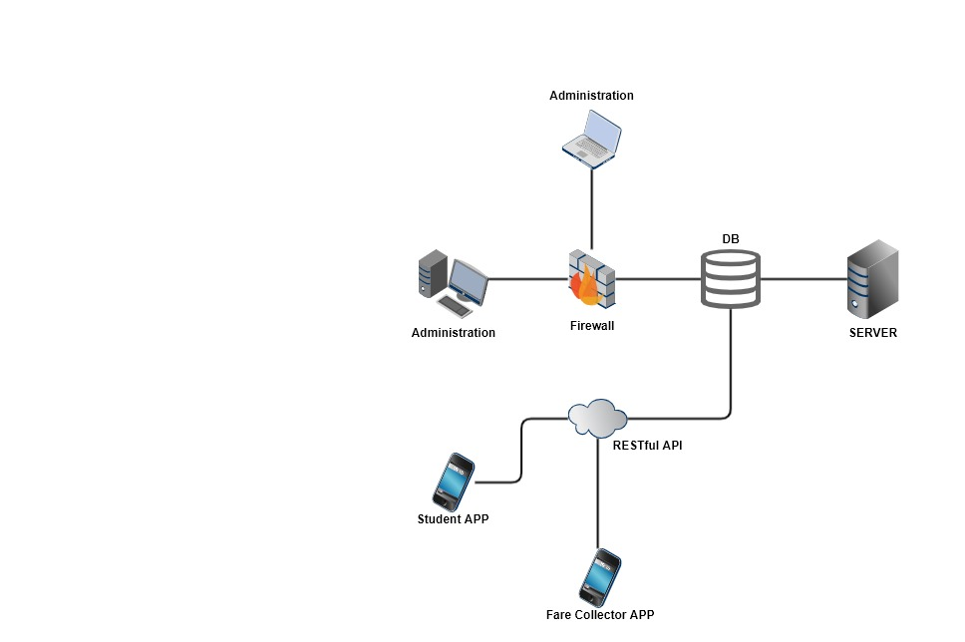
System Design and Architecture
High level Architecture

Slide 9
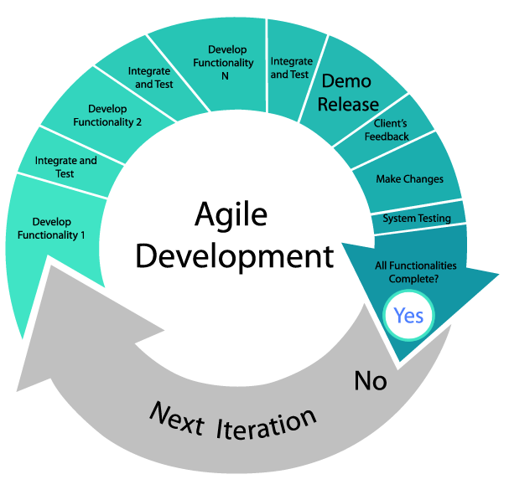
Design and Development Methodology
By using PHP, HTML, CSS languages, we developed a web application for the administration.
For conductor and passengers, we’ve developed and android application.
We’ve used AGILE methodology in our project.

Slide 10
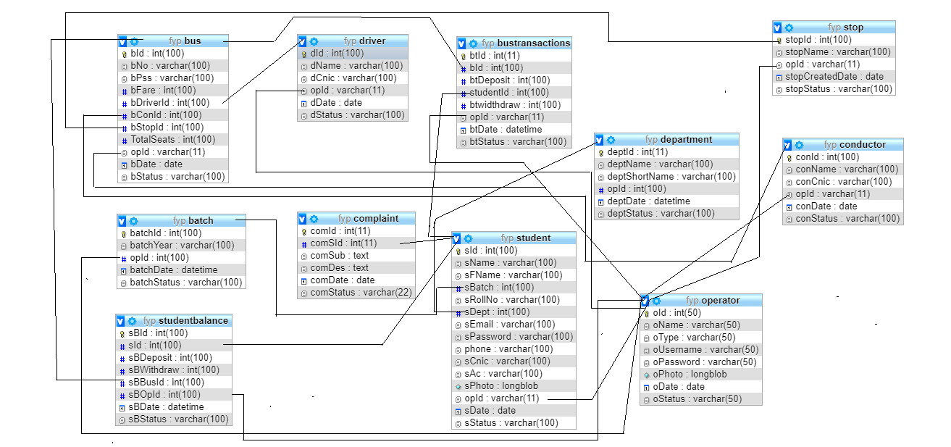
Design and Development Methodology
ER Diagram

Slide 11
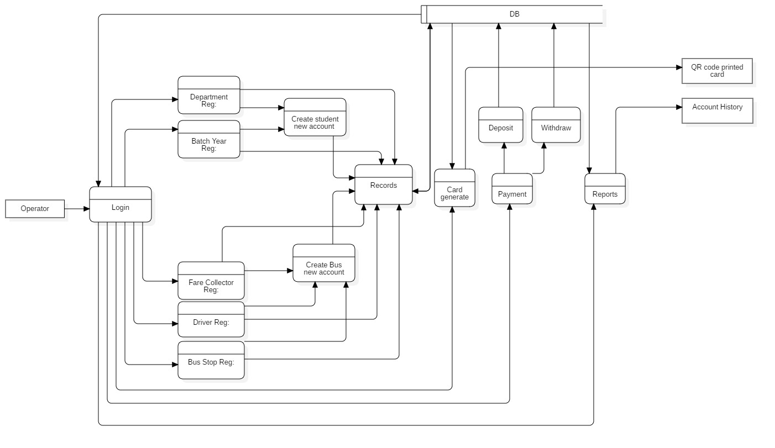
Design and Development Methodology

Slide 12
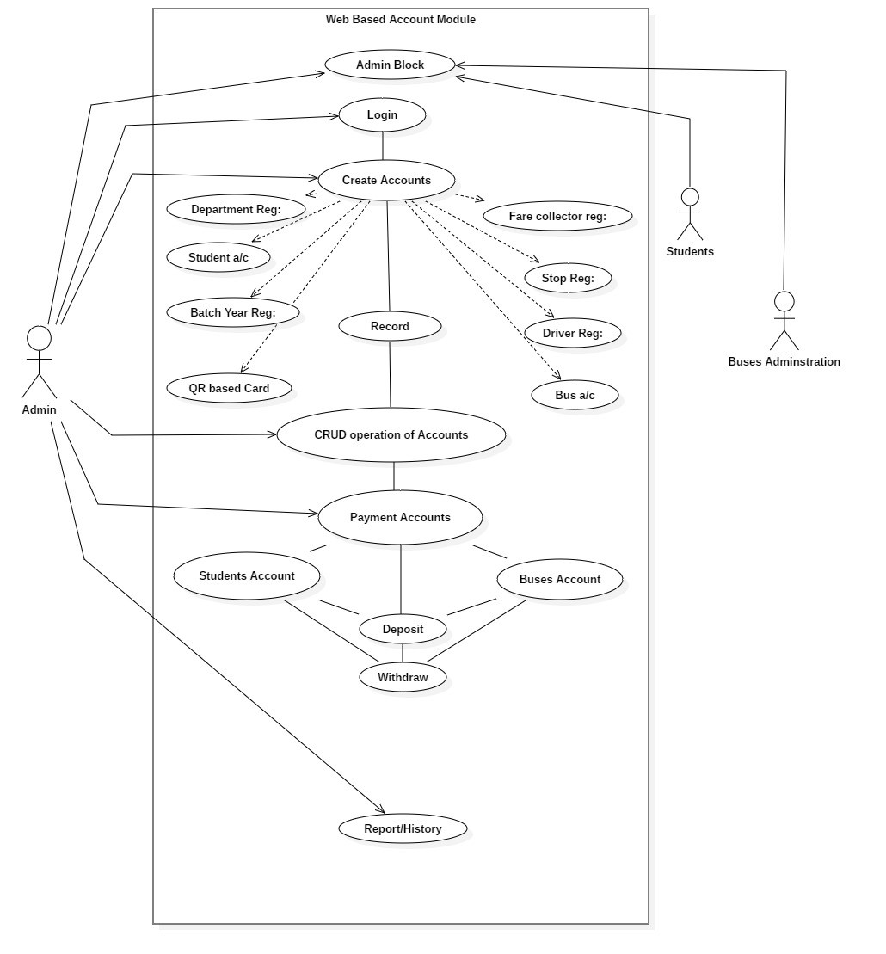
Design and Development Methodology

Slide 13
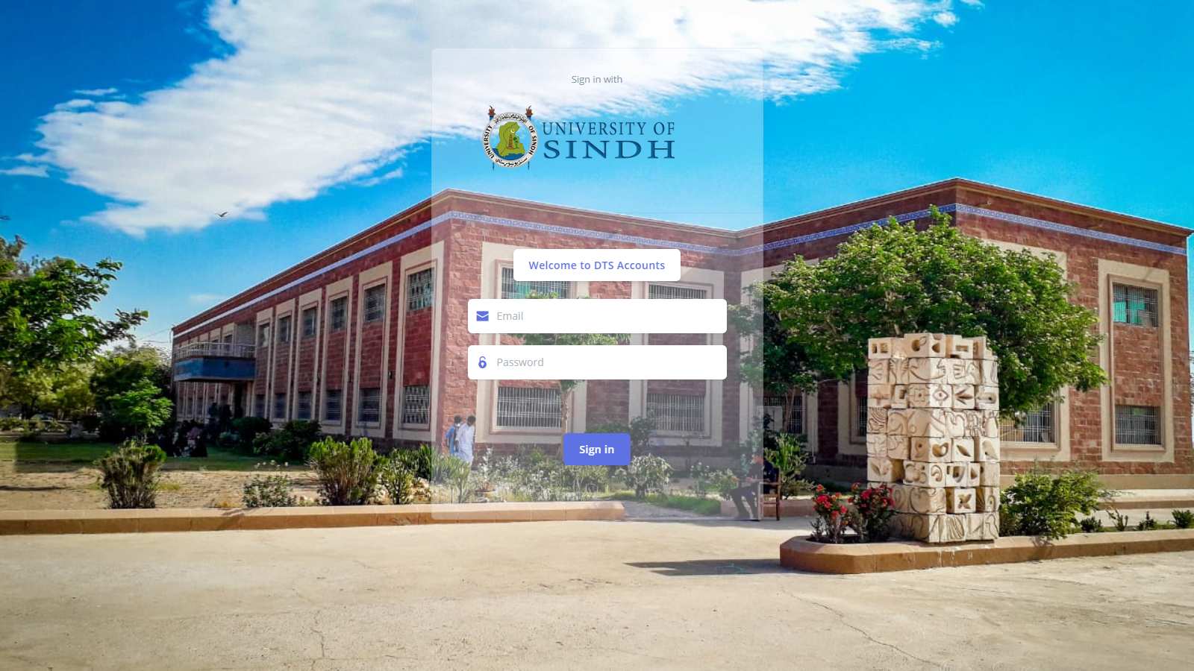
Final Results

Slide 14
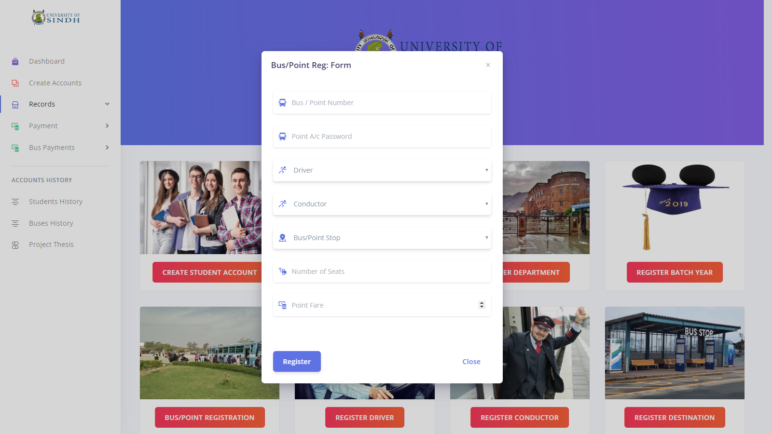
Final Results

Slide 15
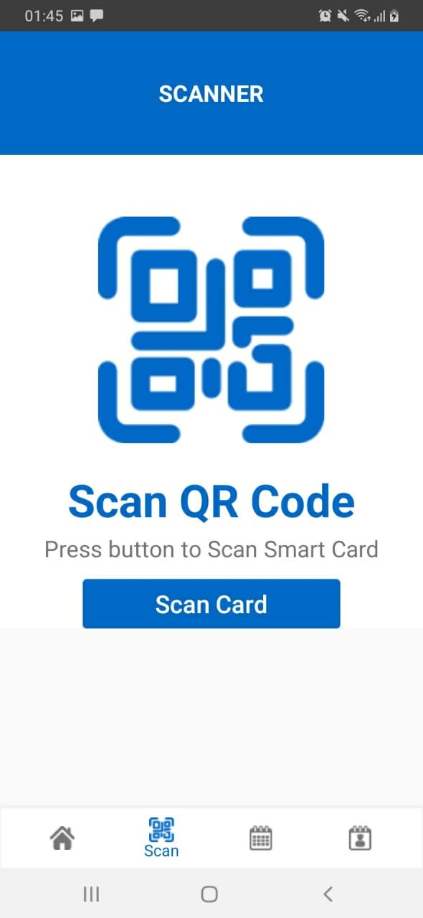
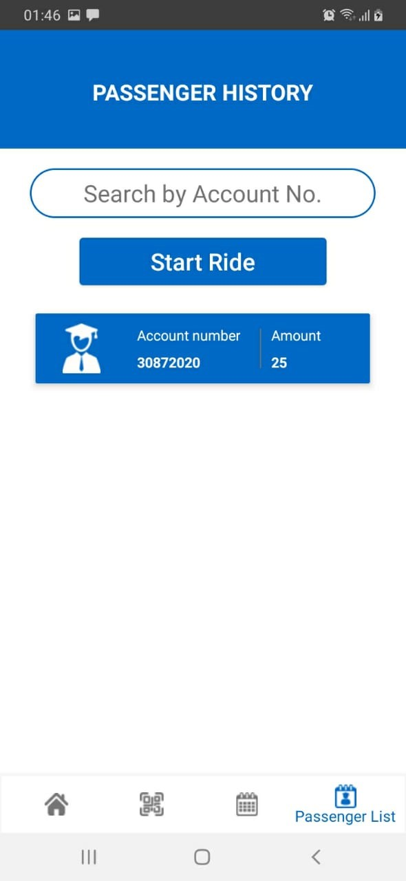
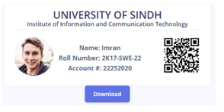
Final Results

Slide 16
Result Achievement and Discussion
Major achievement of this project is that it provides a means for management.
This system is convenient to use, in this way a person who’s using this system for the first time doesn’t require any particular training.

Slide 17
Result Testing and Validation
Sno | Test Case | Required output | Expected output | Test Result
1. | Generating QR Code using Roll number. | Store account number in QR code with Id | AccountNo:42552020,Id:42 | 42552020
2. | Bus Seats Registration | If bus seats aren’t available so transaction will stop | JSON Response: No seat available, wait for other bus | Same result as expected
3. | Amount withdrawal from passengers’ account by operator | If amount to be withdrawn exceeds total balance then error will generate | You have insufficient balance | Same as result

Slide 18
Result Testing and Validation
Sno | Test Case | Required output | Expected output | Test Result
4. | Same bus pass scanned twice by conductor. | Fare should only be deducted once. | Scanning should be stopped after checking if the passenger’s bus card is already scanned. | Error message will be displayed ”Passenger already added ”.
5. | Bus pass with sufficient balance scanned. | Fare should be deducted from account. | Amount will be deducted from passenger’s account and the passenger will be added to the list. | Message will be displayed ”thank you for travelling”.

Slide 19
Conclusion and Future Work
Advanced ticketing system.
From paper currency to digital payment.
Eradicates many problems.
Currently, our system is just automating payment mechanism, in future, we can add tracking feature, in this way our whole system will be automated.
There are many departments in an educational institute that accept paper currency due to which many issues arise, in future, this idea can be implemented in many other departments which accept paper currency.

Slide 20
Contribution of Each Group Member
Muhammad Haaris:
Web application and web services development, thesis.
Mariam Fatima:
Android application development, thesis.

Slide 21
THANK YOU

